Slide 1

Detection of Cannabidiol and Cannabigerol by LC-MS for Kinetic Studies
Gursevak Uppal, Carla Figueroa, Dr. Kingsley Donkor

Slide 2
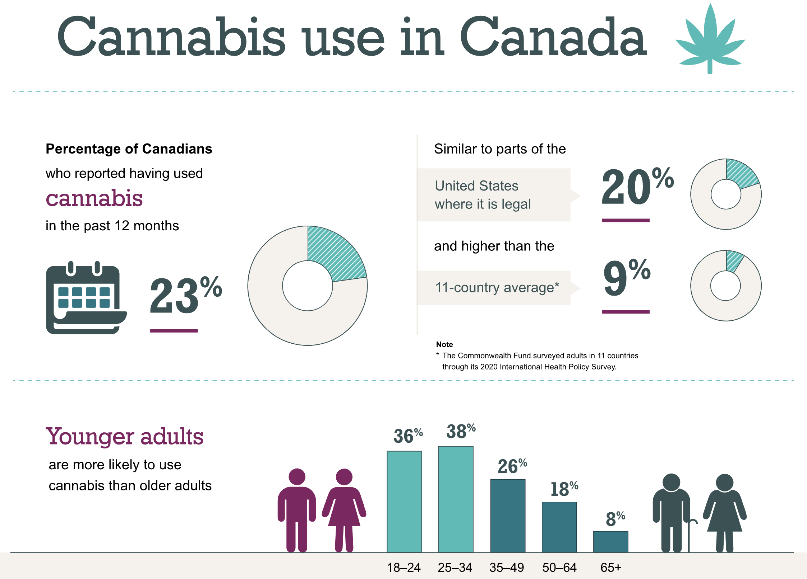
Introduction
Cannabis (Marijuana) is a plant from the Cannabaceae family.
Historically used for thousands of years for medicinal, recreational and industrial purposes
Over 100 chemical compounds in cannabis called Cannabinoids
Figure 1. Infographic about Canadian consumption of cannabis.
Canadian Institute for Health Information. Cannabis use in Canada [infographic]. Ottawa, ON: CIHI; 2021.
Notes:
Canadian Institute for Health Information. Cannabis use in Canada — infographic. Accessed August 30, 2024.

Slide 3
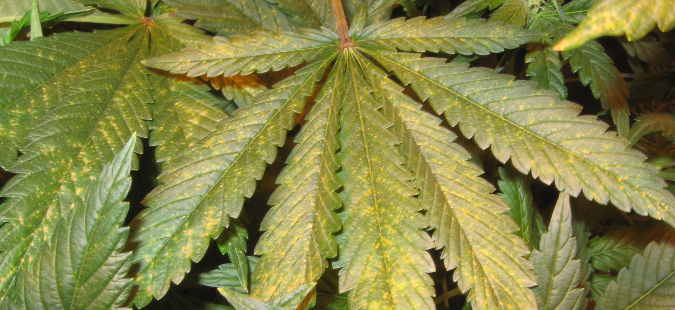
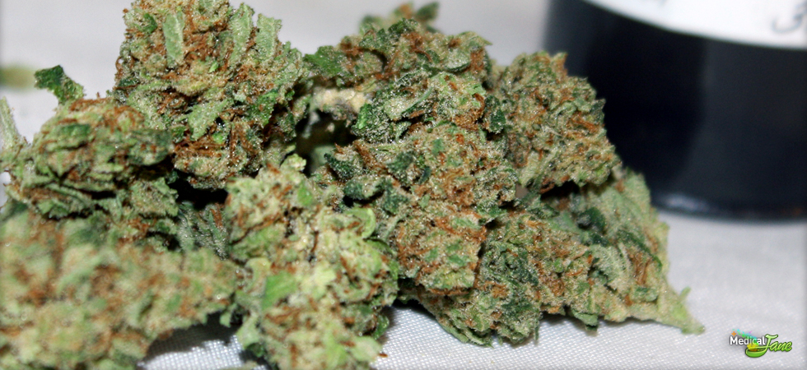
Introduction
Classes of Cannabinoids found in Cannabis:
  Cannabigerols (CBG)
  Cannabidiol (CBD)
  Tetrahydrocannabinol (THC)
  Cannabichromenes (CBC)
  Cannabinol (CBN)
  Cannabinodiol (CBDL)
  Cannabicyclol (CBL)
  Cannabielsoin (CBE)
  Cannabitriol (CBT)
This Photo by Unknown Author is licensed under CC BY-SA-NC
This Photo by Unknown Author is licensed under CC BY-SA-NC

Slide 4
Introduction
CBD is usually sold as an oil and has certain medicinal properties (Antioxidative, Anti-inflammatory) and no psychoactive components.
CBG is known to be neuroprotective
CBG can help with Parkinson's, Alzheimer's, and Neuropathy.
CBG is the decarboxylated form of Cannabigerol acid (CBGA).
CBGA is the parent molecule from which other cannabinoids are synthesized and often referred to as the “mother of all cannabinoids”

Slide 5
Introduction
decarboxylation
CBG
CBGA
CBDA synthase
decarboxylation
CBD
Structures made using ChemDoodle adapted from figure from Technology Networks.
Notes:
CBG is “mother of all cannabinoids” because of CBGA
https://www.news-medical.net/health/What-are-Cannabinoids.aspx#:~:text=Cannabinoids%20are%20naturally%20occurring%20compounds,main%20psychoactive%20ingredient%20in%20cannabis.

Slide 6
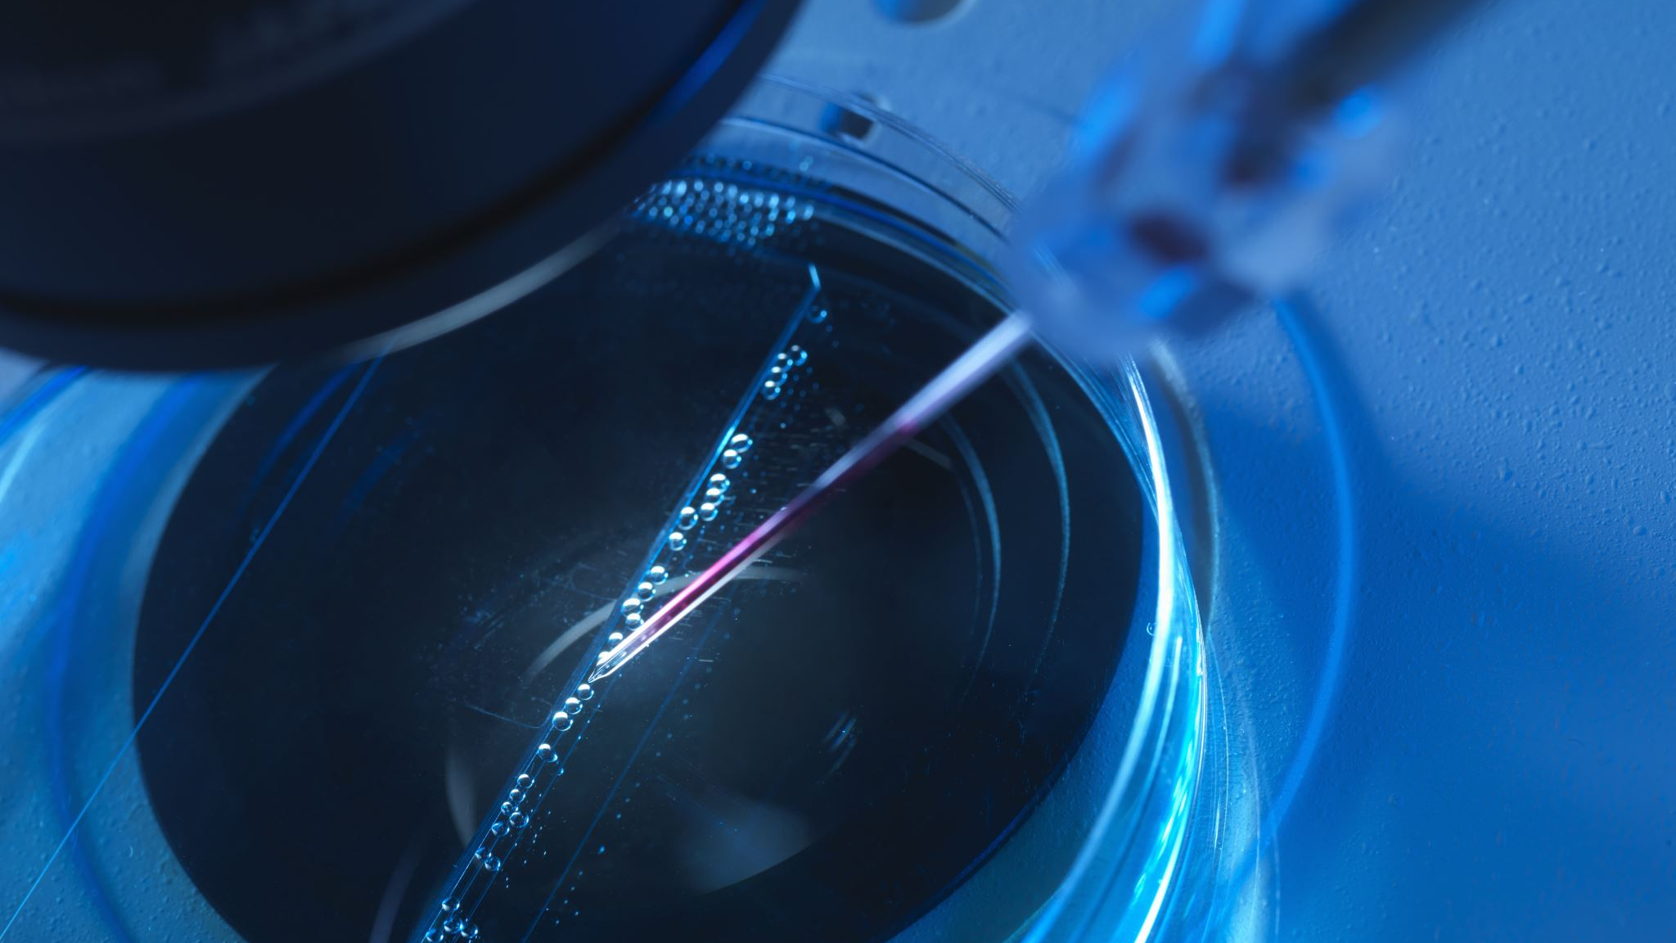
Objective: Separate and detect CBD and CBG

Slide 7
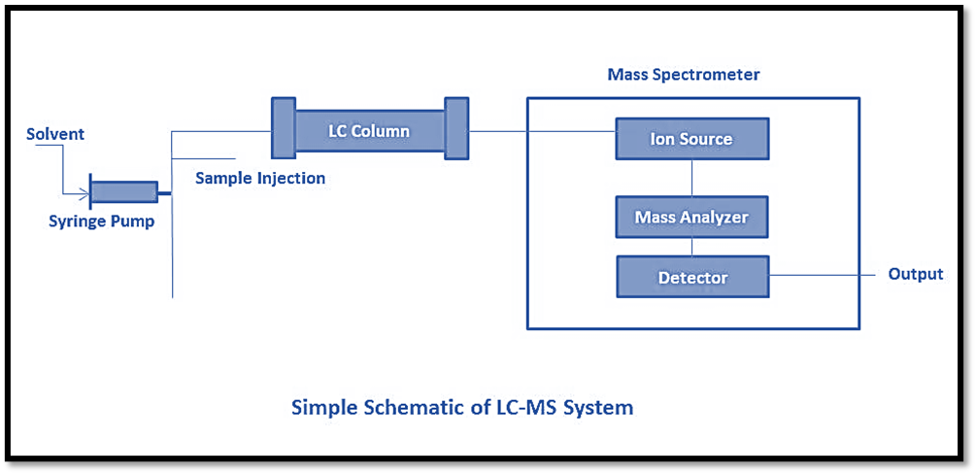
Method: LC-MS
Figure 2. LC-MS Schematic from The Chemistry Notes.

Slide 8
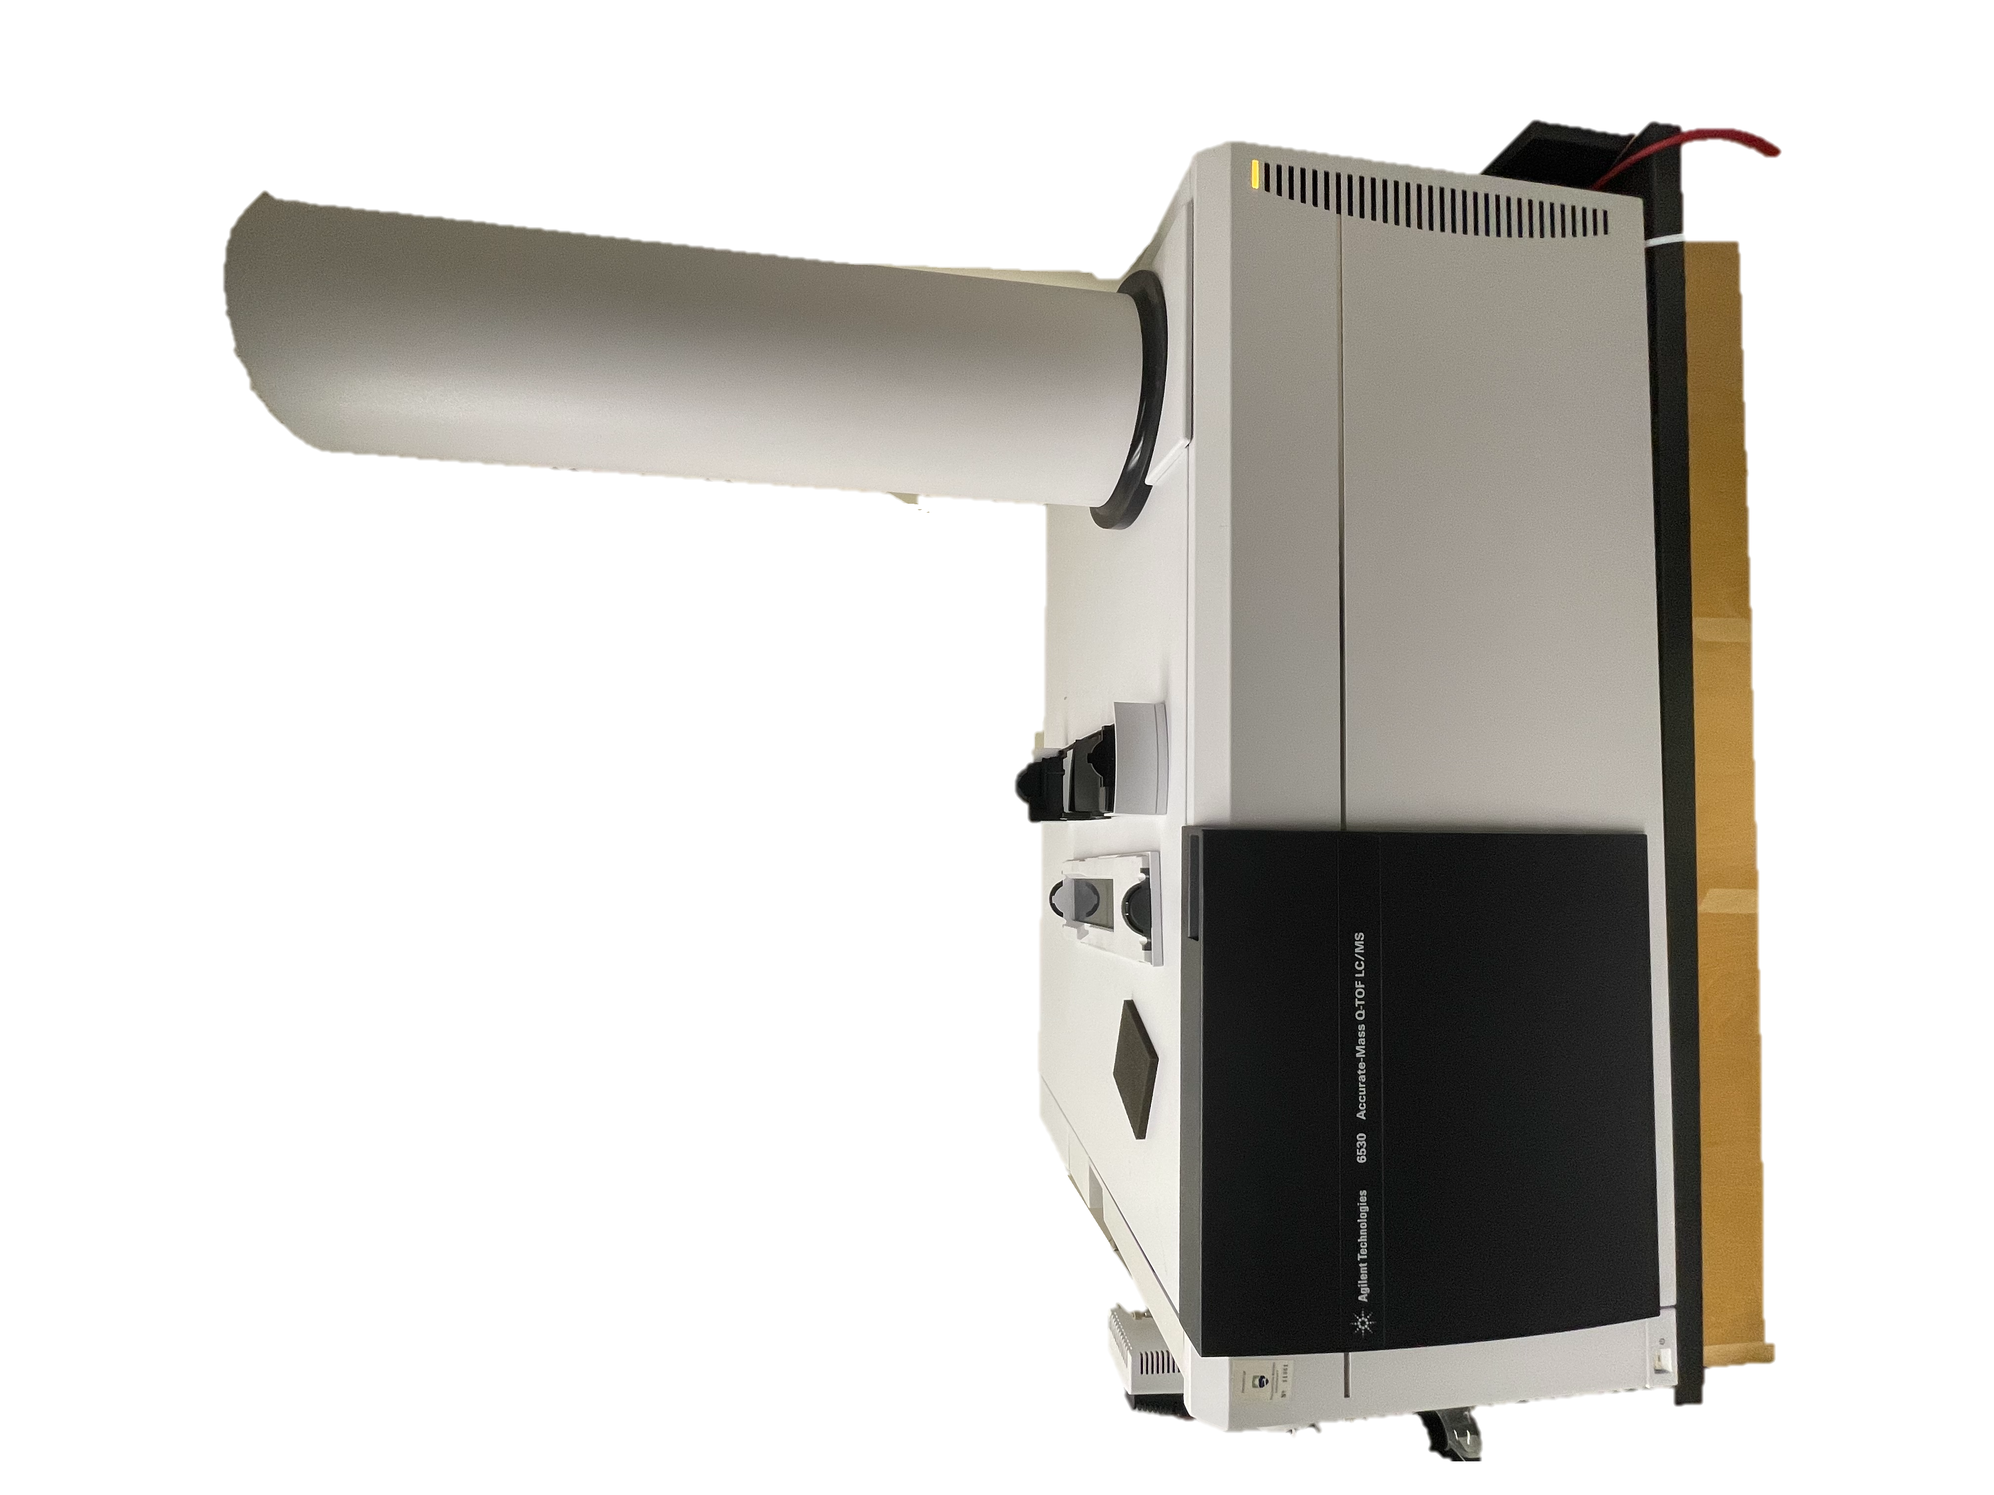
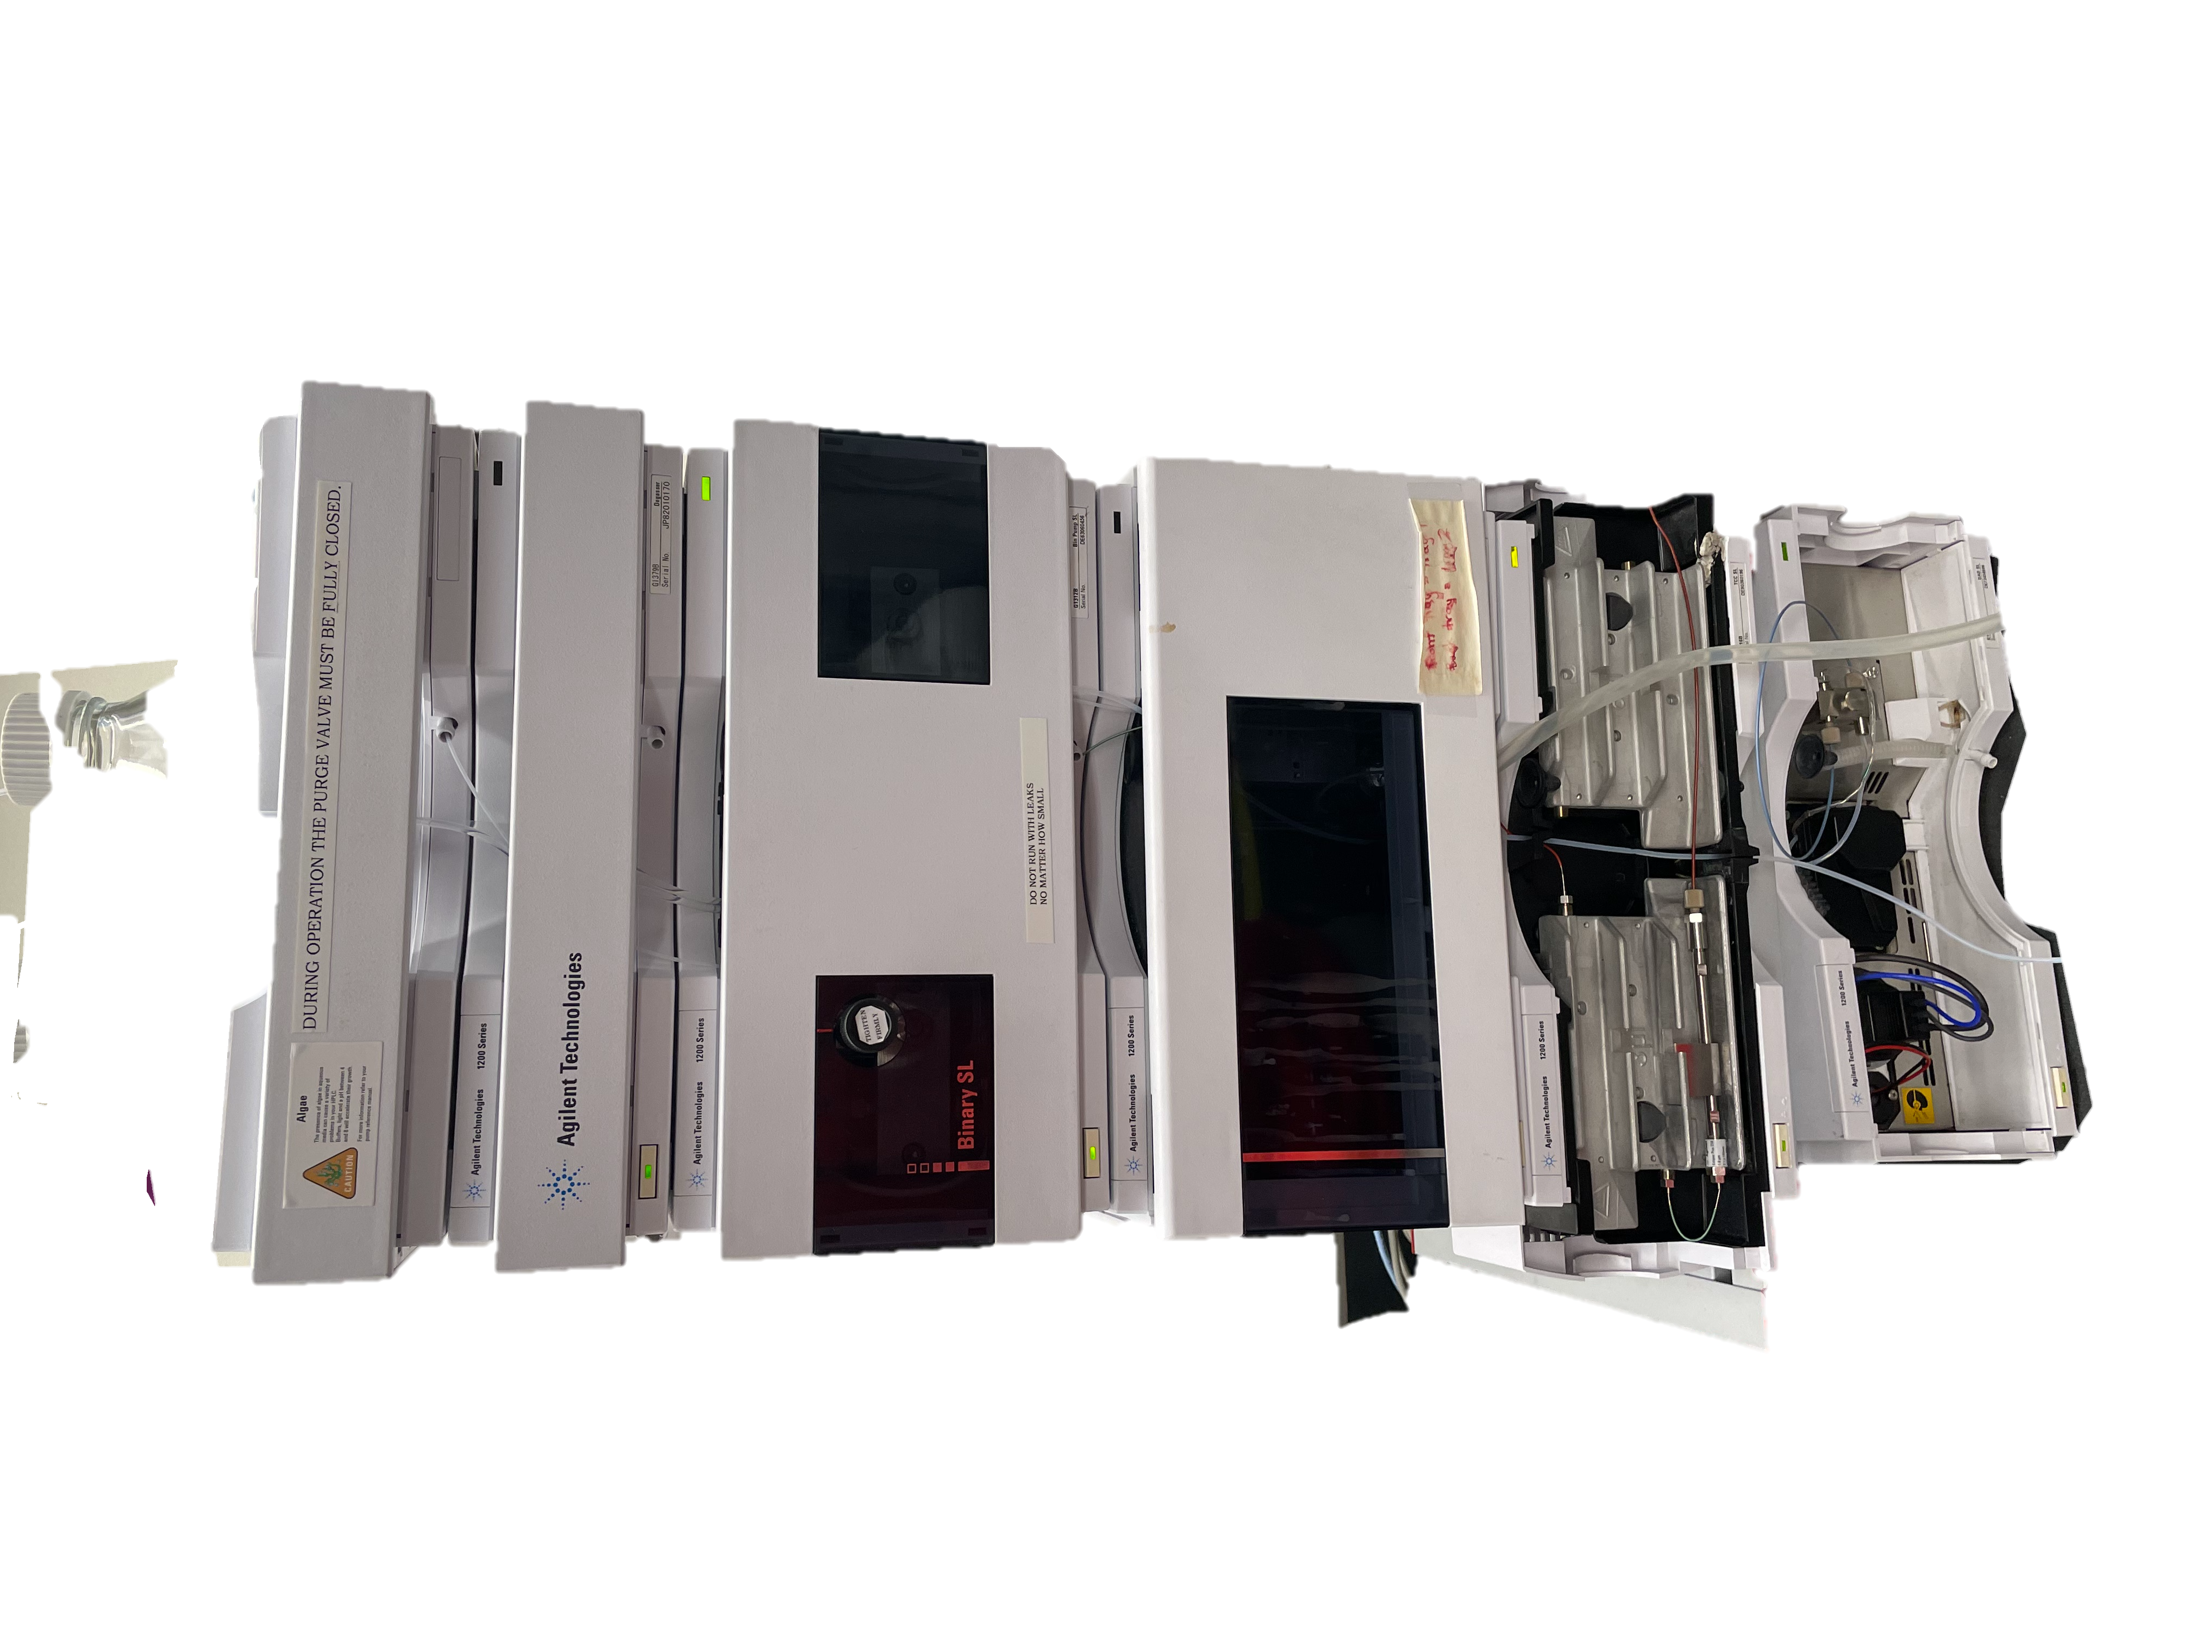
Method: LC-MS
Table 1. LC-MS parameters of method used in study.
Column: | Poroshell 120 EC-C18, 3 x 100 mm, 2.7 mm (Agilent)
Column Temperature: | 30 °C
Flow rate: | 0.3 mL/min
Mobile phase A: | 0.1% formic acid in water
Mobile phase B: | 0.1% formic acid in acetonitrile
Mode of Ionization | ESI +
Mass Range | 100-500 m/z
Figure 3. Agilent 1200 Series 6530 Accurate-Mass Q-TOF LC/MS.

Slide 9
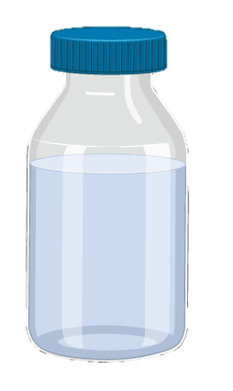
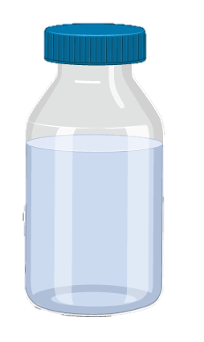
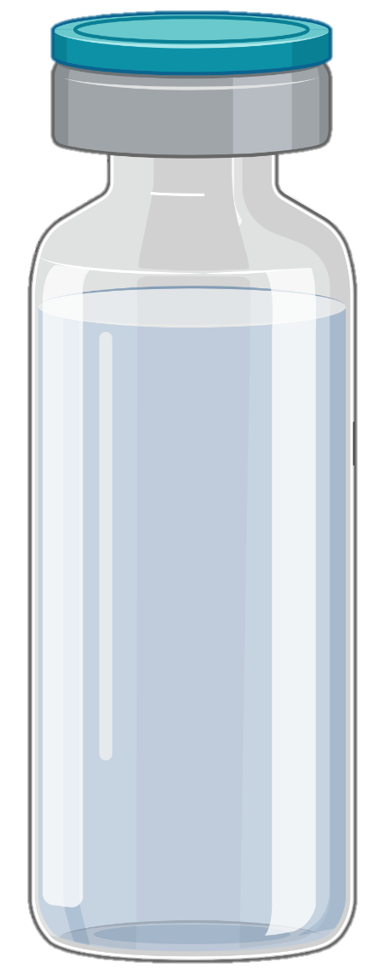
Procedure
Experimental Procedure
Standard solutions were prepared by pipetting appropriate amounts of stock solution into LC vials. Vials were made to 1 mL with Methanol.
10
ppm
15
ppm
20
ppm
25
ppm
CBD
CBG
100 ppm Stock Solutions
Sample mix was made by adding 400 µL of CBD stock solution, 400 µL of CBG stock solution and 200 µL of Methanol
20 ppm
Sample mix
8
Figures made using BioRender.

Slide 10
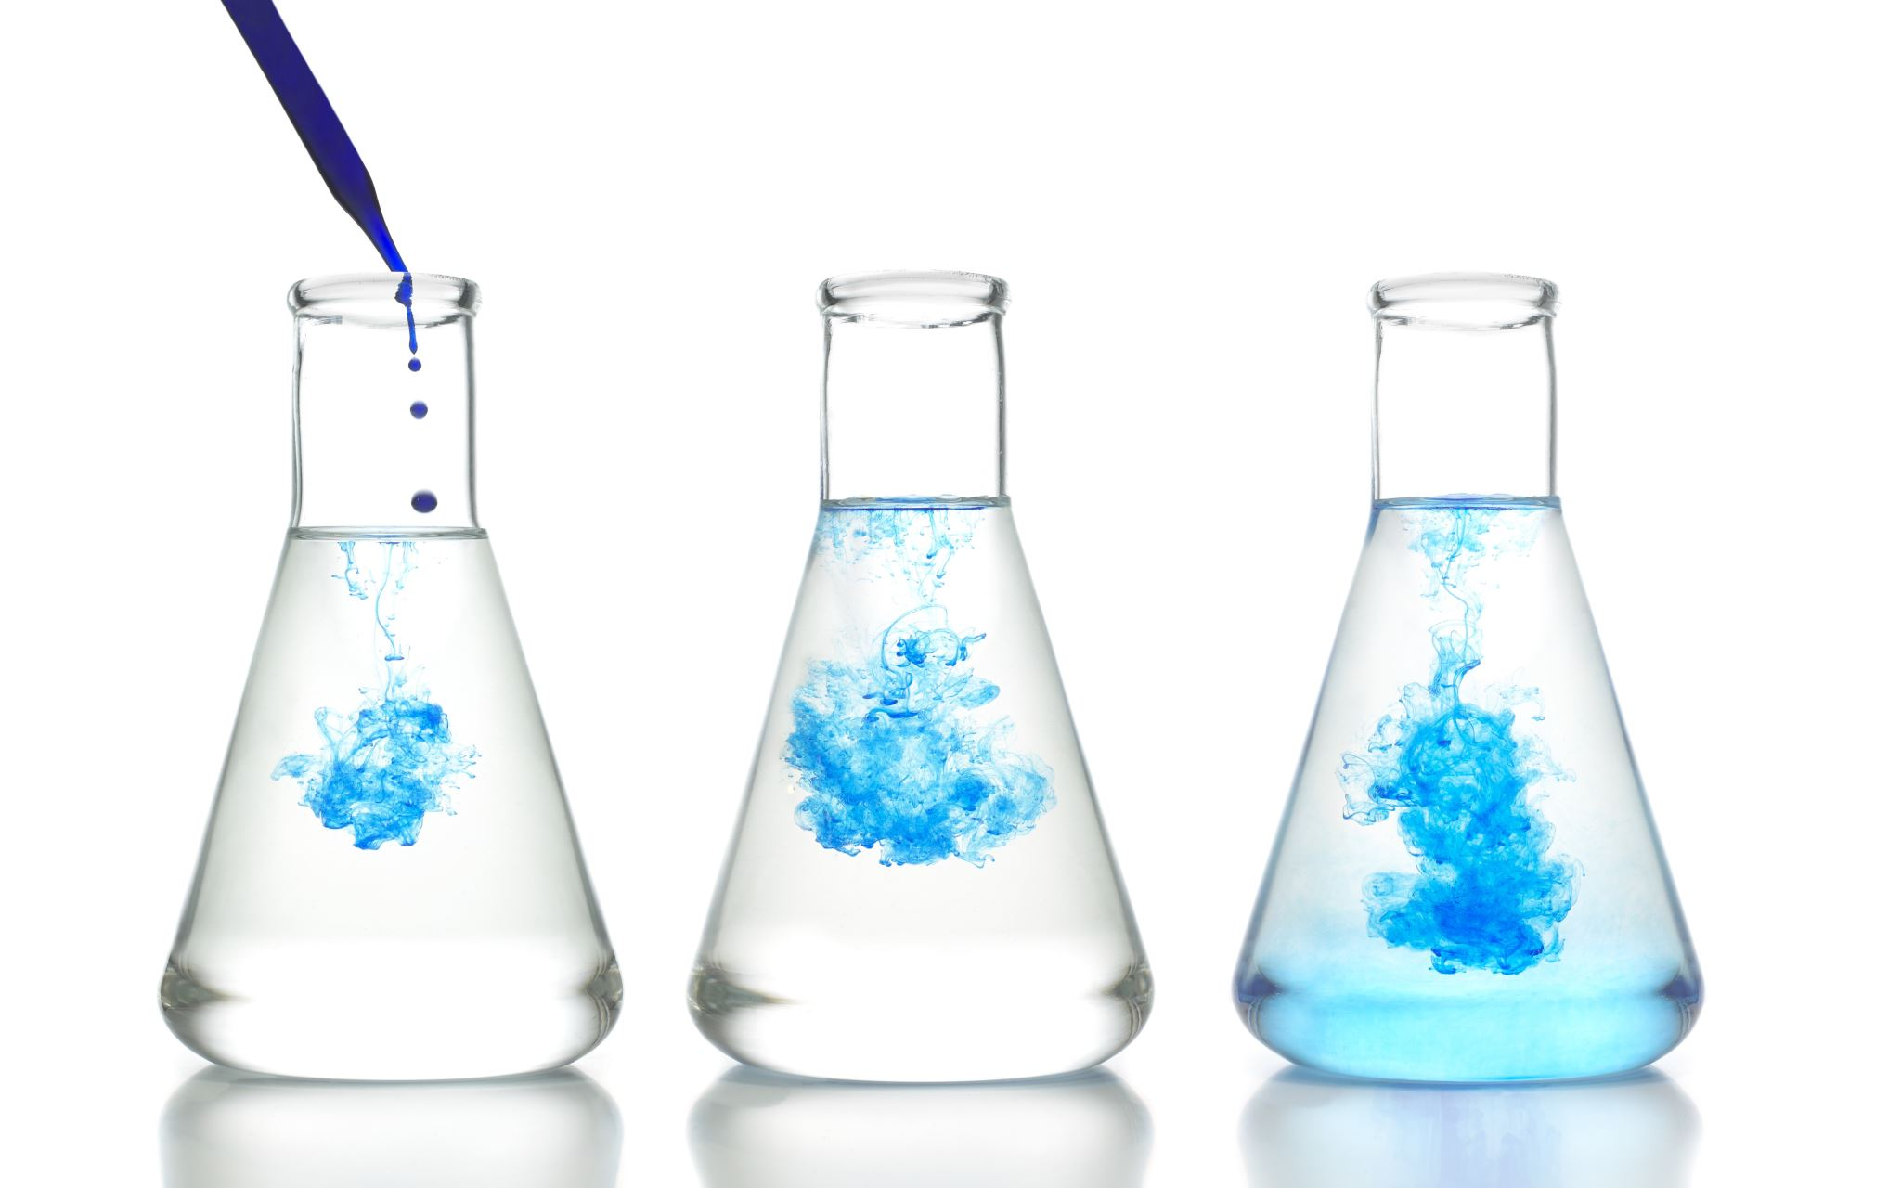
Mobile Phase 60/40
60% 0.1% formic acid in water
40% 0.1% formic acid in acetonitrile

Slide 11
60/40 Results CBD
CBD 10 ppm
CBD 15 ppm
CBD 20 ppm
CBD 25 ppm
Figure 4. Chromatogram of 10 ppm CBD stock solution
Figure 5. Chromatogram of 15 ppm CBD stock solution
CBD
Figure 6. Chromatogram of 20 ppm CBD stock solution
Figure 7. Chromatogram of 25 ppm CBD stock solution
Average Retention Time: 2.76 min
Notes:
60/40

Slide 12
60/40 Results CBG
CBG 10 ppm
CBG 15 ppm
CBG 20 ppm
CBG 25 ppm
Figure 8. Chromatogram of 10 ppm CBG stock solution
Figure 9. Chromatogram of 15 ppm CBG stock solution
Figure 10. Chromatogram of 20 ppm CBG stock solution
Figure 11. Chromatogram of 25 ppm CBg stock solution
Average Retention Time: 6.12 min
Notes:
60/40

Slide 13
60/40 Solvent Ratio
Figure 12. Calibration curve of CBD and CBG standards using 60/40 solvent ratio obtained by LC-MS.

Slide 14
Mobile Phase 80/20
80% 0.1% formic acid in water
20% 0.1% formic acid in acetonitrile

Slide 15
80/20 Results CBD
CBD 10 ppm
CBD 15 ppm
CBD 20 ppm
CBD 25 ppm
Figure 13. Chromatogram of 10 ppm CBD stock solution
Figure 14. Chromatogram of 15 ppm CBD stock solution
Figure 15. Chromatogram of 20 ppm CBD stock solution
Figure 16. Chromatogram of 25 ppm CBD stock solution
CBD
Average Retention Time: 5.13 min
Notes:
80/20

Slide 16
80/20 Results CBG
CBG 10 ppm
CBG 15 ppm
CBG 20 ppm
CBG 25 ppm
Figure 17. Chromatogram of 10 ppm CBG stock solution
Figure 18. Chromatogram of 15 ppm CBG stock solution
Figure 19. Chromatogram of 20 ppm CBG stock solution
Figure 20. Chromatogram of 25 ppm CBg stock solution
Average Retention Time: 3.56 min
Notes:
80/20

Slide 17
80/20 Solvent Ratio
Figure 21. Calibration curve of CBD and CBG standards using 80/20 solvent ratio obtained by LC-MS.

Slide 18
Mobile Phase 90/10
90% 0.1% formic acid in water
10% 0.1% formic acid in acetonitrile

Slide 19
90/10 Results CBD
CBD 10 ppm
CBD 15 ppm
CBD 20 ppm
CBD 25 ppm
Figure 22. Chromatogram of 10 ppm CBD stock solution
Figure 23. Chromatogram of 15 ppm CBD stock solution
CBD
Figure 24. Chromatogram of 20 ppm CBD stock solution
Figure 25. Chromatogram of 25 ppm CBD stock solution
Average Retention Time: 4.14 min
Notes:
90/10

Slide 20
90/10 Results CBG
CBD 10 ppm
CBD 15 ppm
CBD 20 ppm
CBD 25 ppm
Figure 26. Chromatogram of 10 ppm CBG stock solution
Figure 27. Chromatogram of 15 ppm CBG stock solution
Figure 28. Chromatogram of 20 ppm CBG stock solution
Figure 29. Chromatogram of 25 ppm CBg stock solution
Average Retention Time: 3.80 min
Notes:
90/10

Slide 21
90/10 Solvent Ratio
Figure 30. Calibration curve of CBD and CBG standards using 90/10 solvent ratio obtained by LC-MS.

Slide 22
Mobile Phase 85/15
85% 0.1% formic acid in water
15% 0.1% formic acid in acetonitrile

Slide 23
85/15 Results CBD
CBD 10 ppm
CBD 15 ppm
CBD 20 ppm
CBD 25 ppm
Figure 31. Chromatogram of 10 ppm CBD stock solution
Figure 32. Chromatogram of 15 ppm CBD stock solution
Figure 33. Chromatogram of 20 ppm CBD stock solution
Figure 34. Chromatogram of 25 ppm CBD stock solution
CBD
Average Retention Time: 2.43 min
Notes:
85/15

Slide 24
85/15 Results CBG
CBD 10 ppm
CBD 15 ppm
CBD 20 ppm
CBD 25 ppm
Figure 35. Chromatogram of 10 ppm CBG stock solution
Figure 36. Chromatogram of 15 ppm CBG stock solution
Figure 37. Chromatogram of 20 ppm CBG stock solution
Figure 38. Chromatogram of 25 ppm CBg stock solution
Average Retention Time: 1.74 min
Notes:
85/15

Slide 25
85/15 Solvent Ratio
Figure 39. Calibration curve of CBD and CBG standards using 85/15 solvent ratio obtained by LC-MS.

Slide 26

Mobile Phase 80/20
85% 0.1% formic acid in water
15% 0.1% formic acid in acetonitrile

Slide 27
Can we use this to separate a mixture of CBD and CBG?
20 ppm CBD
20 ppm CBG
Figure 40. 20ppm CBD and CBG mix chromatogram using 80/20 solvent ratio.
Notes:
sample vial with 20ppb cbd and cbg and make ms data bigger. duplicate then

Slide 28
Can we use this to separate a mixture of CBD and CBG?
315.2614
317.2755
Figure 41. Mix Sample CBD Mass Spectrum
Figure 42. Mix Sample CBG Mass Spectrum
Notes:
sample vial with 20ppb cbd and cbg and make ms data bigger. duplicate then

Slide 29
Conclusions and Future Work
CBD and CBG standards ranging from 5 ppm to 25 ppm were able to be detected individually.
CBD and CBG were able to be detected in a sample containing both compounds.
The method was optimized to yield sharp peaks.
Future Directions
Test the stability of CBG in different conditions.
Test the kinetics of conversion of CBG to Δ9-Tetrahydrocannabinol (THC).
Optimize the method for the separation of the CBD and CBG peaks.
Test for detection of CBD in pet food products

Slide 30
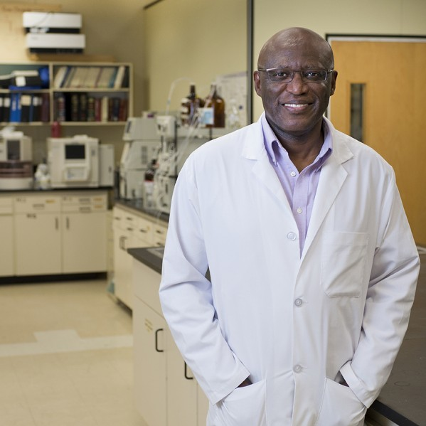



Acknowledgements
I would like to thank Dr. Kingsley Donkor for his guidance and support.
I would also like to thank Carla Figueroa for her help with this project, Western Diversification Canada for the purchase of the LC-MS, and TRU Department of Chemistry for resources.
Dr. Kingsley Donkor
Carla Figueroa

Slide 31
Sample Mix of CBD and CBG using 90/10 Solvent Ratio

Slide 32
Sample Mix of CBD and CBG using 90/10 Solvent Ratio

Slide 33
Sample Mix of CBD and CBG using 60/40 Solvent Ratio

Slide 34
60/40 CBD and CBG
CBD
Avg RT: 2.76 min
CBG
Avg RT: 6.12 min
10 ppm
15 ppm
20 ppm
25 ppm

Slide 35
80/20 CBD and CBG
CBD
Avg RT: 5.13 min
CBG
Avg RT: 3.56 min
10 ppm
15 ppm
20 ppm
25 ppm

Slide 36
90/10 CBD and CBG
CBD
Avg RT: 4.21 min
CBG
Avg RT: 3.78 min
10 ppm
15 ppm
20 ppm
25 ppm

Slide 37
85/15 CBD and CBG
CBD
Avg RT: 2.43 min
CBG
Avg RT: 1.74 min
10 ppm
15 ppm
20 ppm
25 ppm

